Slide 1
-:WBC Multiclass Classification :- -: Project Midway :-
Done and Submitted by :
Girish Tripathy
Shashank Saumya
Instructor:
Dr. Subhankar Mishra

Slide 2
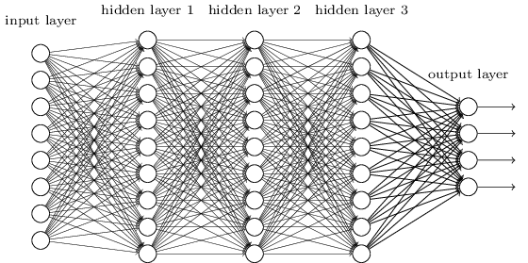
Neural Networks
Neural Networks are large mesh with weights attached to each edge.
Multiple Layers, each has its own job.
Back Propagation of error.

Slide 3
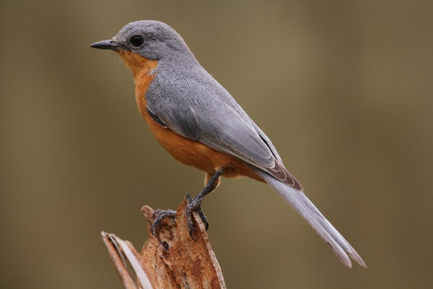
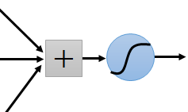
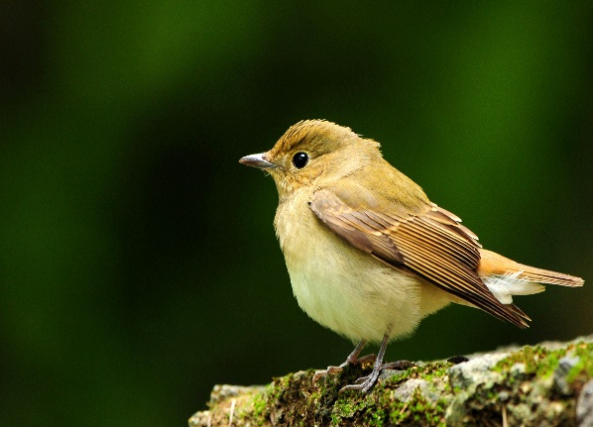
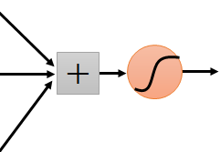
Patterns
We are good at finding patterns in images.
Patterns can be at different places.
“upper-left beak” detector
They can be compressed
to the same parameters.
“middle beak” detector

Slide 4
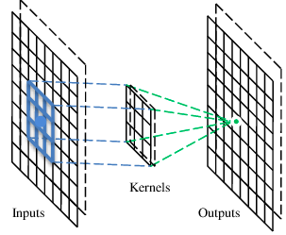
Convolutional Layer
NN with Convolutional Layers are called CNN
They look for patterns in the images (patterns in the pixel matrix of image)
Each Layer has multiple filters, each filter can look for different types of patterns
Beak detector
A filter

Slide 5
Pooling
Pooling reduces data size while trying to not lose much information.
Different types of pooling
Max
Min
Average
Example of Max pooling:-
Take grids of size 3x3 and replace by the maximum number in it.

Slide 6

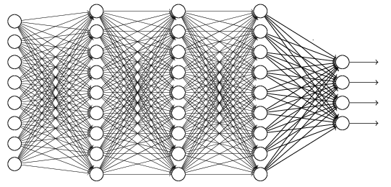
The whole CNN
cat dog ……
Convolution
Max Pooling
Can repeat many times
Fully Connected NN
Convolution
Max Pooling
Flattened

Slide 7
-:Analysis of Papers:-
Paper 1: White Blood Cell Classification using CNN
Use the same WBC data (with some augmentation and downsizing)
Use a 7 layered (LeNet) CNN model
Try for different epochs and learning rate.
Best result at 20 Epochs and 0.001 Learning Rate (0.8793 accuracy)

Slide 8
-:Analysis of Papers:-
Paper 2: Counting and Classification of White Blood Cell using ANN
They have the image of a slide which contains multiple WBCs
Use Image Segmentation Techniques
Cell Segmentation
Nucleus Segmentation
Morphological features are extracted like, Cell area, nucleus area, area ratio, number of lobules in nucleus, etc.
Use NN to perform multiclass Classification
However, they only had 90 leukocyte (WBC) samples which is very small data
The accuracy was 98.9%(overall).

Slide 9
Experiments and Results so far
Mnist database : NN single layered :- 92.80 % testing accuracy
Mnist database : NN multi-layered :- 98.04 %
Cifar10 database : NN Multilayered, SGD optimiser, 55.33% accuracy
Cifar10 Database : NN Multilayered, Adam optimiser, 48 % accuracy
Cifar10 Database : NN Multilayered, SGD optimiser, + one hot encoding, 56% accuracy
Cifar10 Database : CNN multi-layered (2 Conv2D layers) + adam + softmax, training accuracy = 93% , testing accuracy = 68%
(Our database) WBC database : CNN multi-layered (same model as above), training accuracy = 100% Testing accuracy = 48%. Overfitting :(

Slide 10
What’s Next?
Data Augmentation.
Use Image segmentation (Paper 2).
Understand LeNet and if possible come up with a better model/layer combination.
Use GridSearchCV from scikit library to find the best hyperparameters.

Slide 11
References
Information on NN:-
Basic NN:- Course on coursera by Andrew Ng
CNN:- Ming Li (MIT, waterloo) lectures on Deep Learning and google
Research Papers:-
M. Sharma, A. Bhave, R.R. Janghel, White Blood Classification using Convoluted Neural Networks, Springer 2019
S. Manik, L.M. Saini, N.Vadera, Counting and classification of white blood cell using Artificial Neural Network (ANN), in IEEE International Conference on Power Electronics, Intelligent Control and Energy Systems (ICPEICES), IEEE (2016)

